Slide 1
Create a chatbot in python RVs technical campus - coimbatore Be.computer science & engineering presented by i.keerthigA

Slide 2
SynOpsIs
Introduction.
What is chatbot?
History of chatbot.
Problem with current scenerio.
How does it work?
List of best AI Chatbot.
Application.
Limitation.
Advantages.
Disadvantages.
Conclusion.

Slide 3
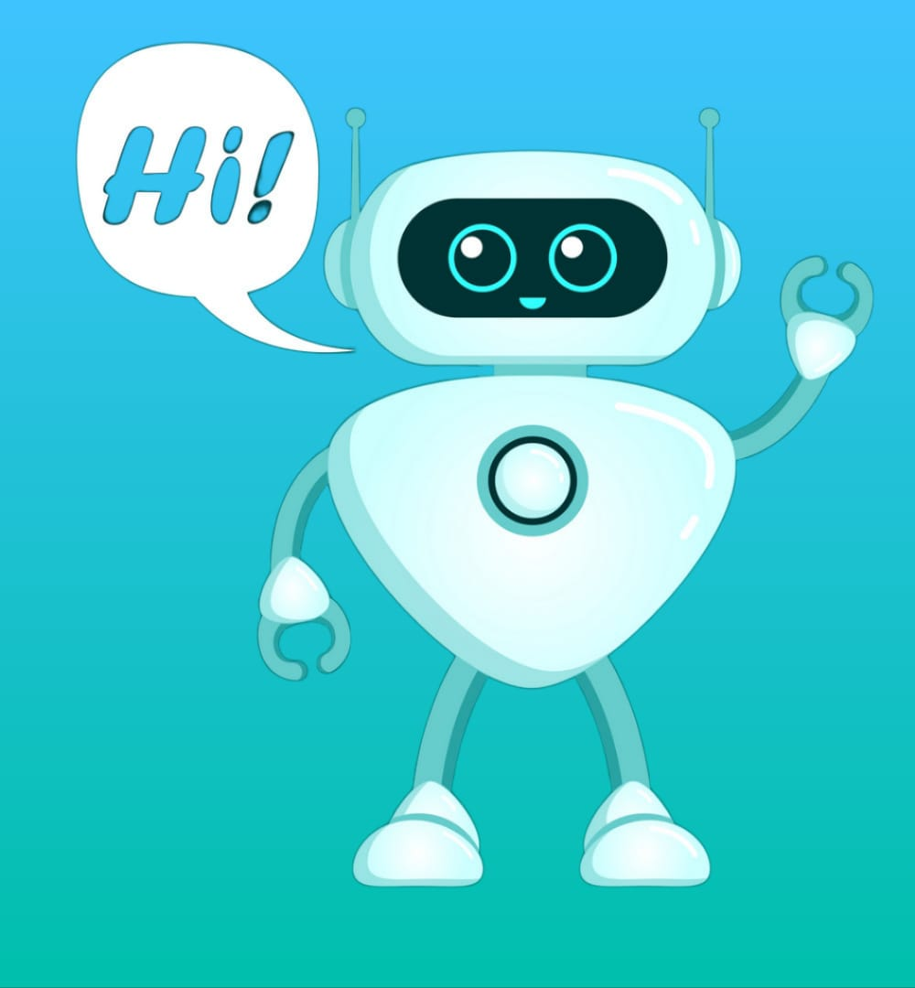
Introduction:
A chatbot (conversational interface, AI agent) is a
computer program that can understand human
language and converse with a user via a website
or a messaging app. Chatbots can handle various
tasks online — from answering simple questions and
scheduling calls to gathering customer feedback.

Slide 4
What is a chatbot?
Chatbot is a computer program that simulates human conversation with an end user.
Though not all chatbots are equipped with artificial intelligence (AI), modern chatbots increasingly use conversational AI techniques like natural language processing (NLP) to understand the user’s questions and automate responses to them.

Slide 5
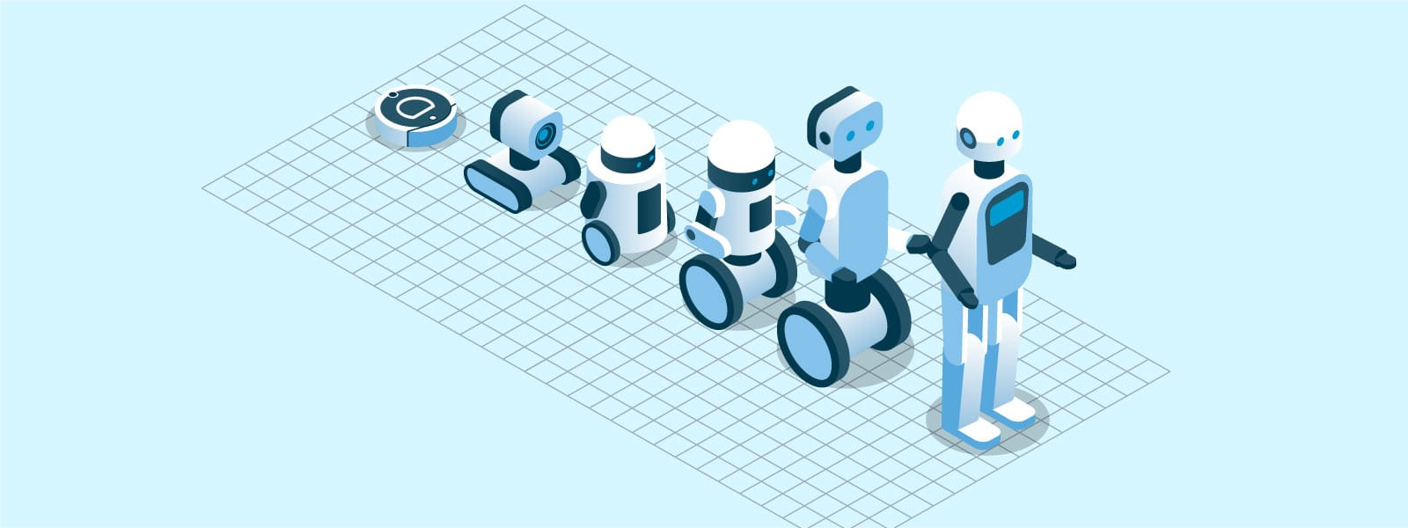
History of chatbot
In 1950, Alan Turing wondered if a computer program could talk to a group of people without realizing that their interlocutor was artificial. This question, named Turing test, is considered by many to be the generative idea of chatbots (Turing, 1950). The first chatbot with ELIZA name was constructed in 1966.

Slide 6

Problems with current scenerio:
They may create false narratives are to
propagate misinformation.
They can be used to exploit vulnerable people.
Data privacy is unreliable with chatbots.
They theft, keylogging sensitive information
such as passwords, bank details and addresses,
and phishing.

Slide 7
How dose it works?
AI chatbot responds to questions posed to it in natural language as if it were a real person.
It responds using a combination of pre-programmed scripts and machine learning algorithms. When asked a question, the chatbot will answer using the knowledge database that is currently available to it.
Chatbot algorithms include the following:
Sequence to Sequence (seq2seq) model;
Natural Language Processing (NLP);
Long Short Term Memory (LSTM)

Slide 8
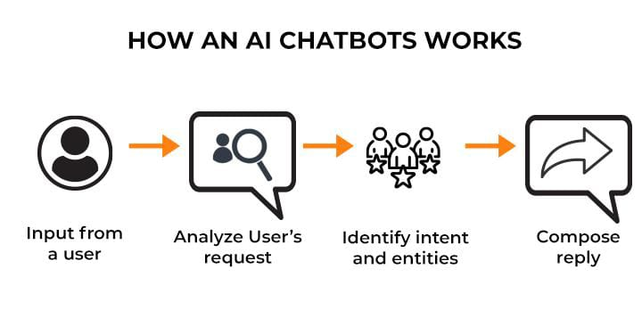

Slide 9
List of Best Ai chatbot:
ELIZA - Joseph Weizenbaum.
Mitsuku - Steve Worswick.
Chatgpt - Open AI.
Dialogflow - Google.
Replika - Eugenia Kuyda.
Cleverbot - Rollo Carpenter.

Slide 10
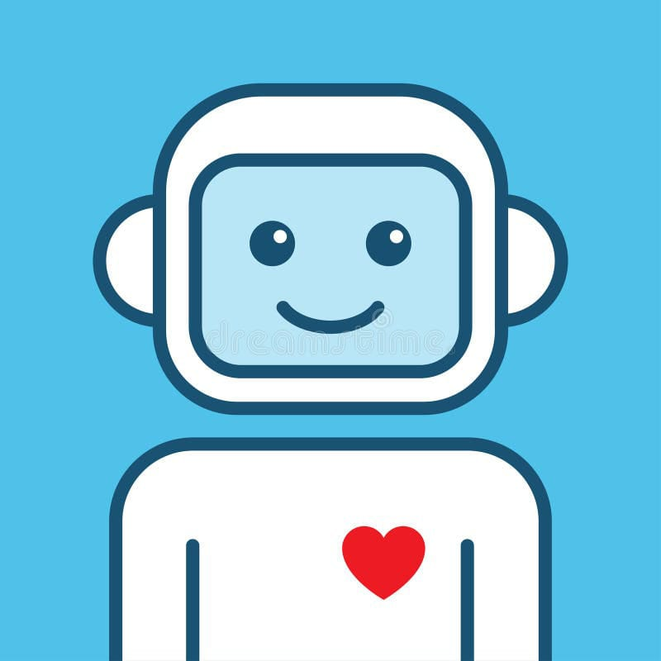
Application:
Retail and E-Commerce
Travel and Hospitality
Banking
Agriculture domain
Medicine
Education
Finance

Slide 11
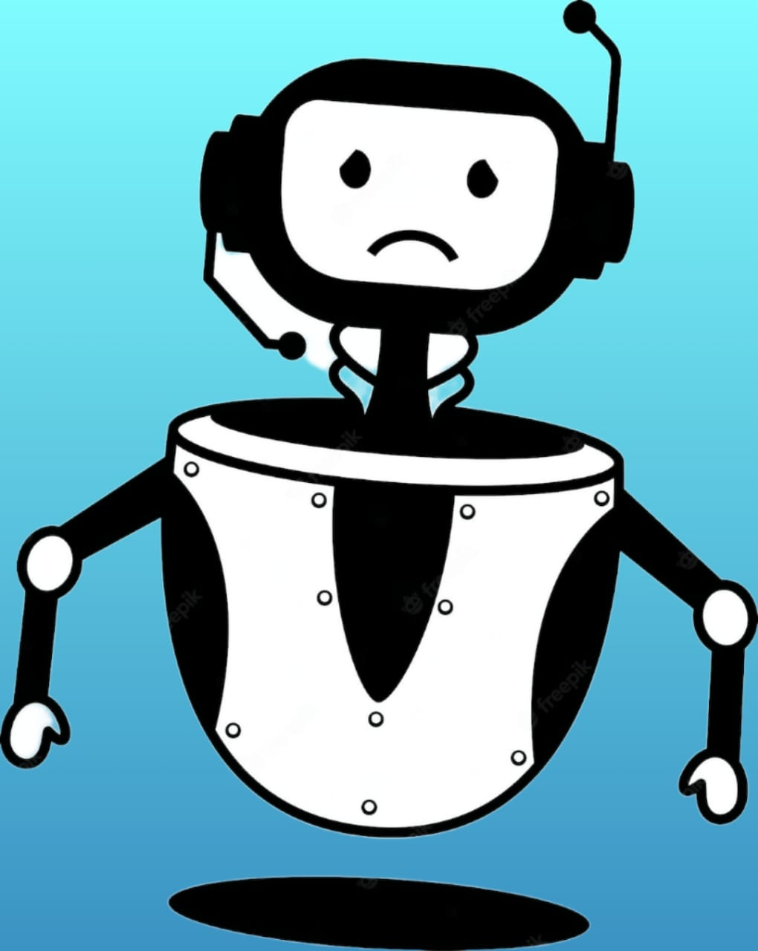
Limitations:
Lack of empathy
Biased answers
Inability to understand
Unnecessary multitasking
No emotions
Lack of robustness

Slide 12
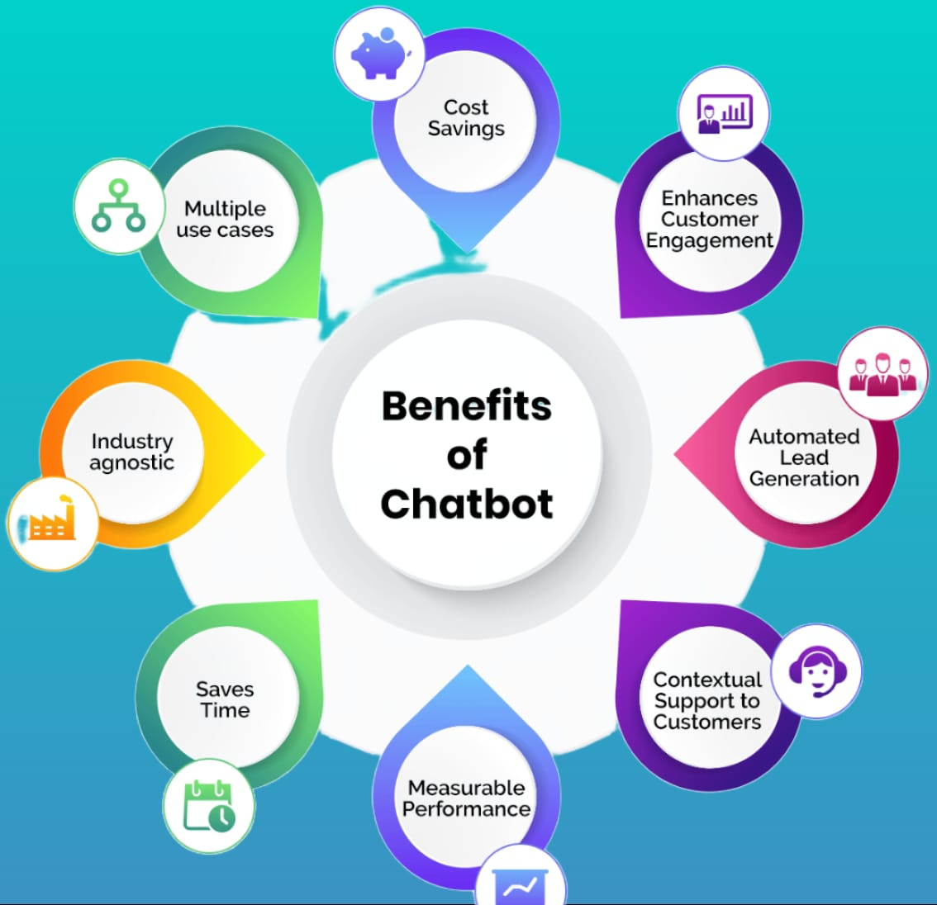
Advantages

Slide 13
Disadvantages
Require maintenance
Difficult to create
It require active internet connection as error may occur
Lack emotion
Implementation and maintanence costs
Can only show previously programed contents

Slide 14
Conclusion:
A chatbot is one of the simple ways to transport data from a computer without having to think for proper keywords to look up in a search or browse several web pages to collect information; users can easily type their query in natural language and retrieve information.

Slide 15


